Slide 1

OK Cupid
Team B3
Hanyu Chen, Yipeng Guo, Luke Hong, Ting-Ann Lu, Yuyan Ma

Slide 2
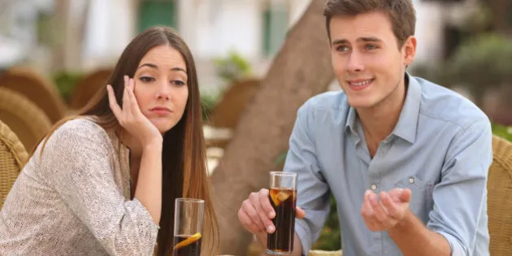
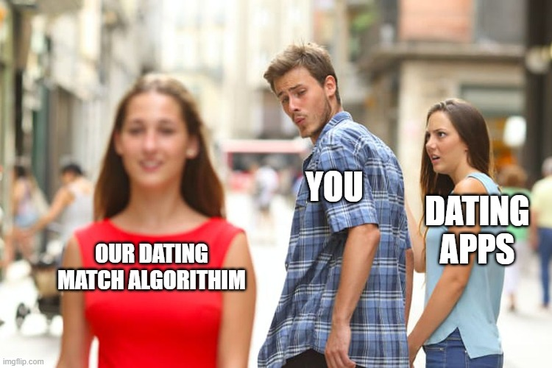
Motivation
Notes:
Have you ever had a bad first date from a dating app? Do you never get any matches? Do your matches never respond to your messages or unmatch you? Well fear no more and never have a bad date again with our dating algorithm.

Slide 3
Data Overview / Cleaning
16
Variables
14 Categorical Variables
2 Numeric Variables
Categorical Variables
Full_essay
Location
pets
age
status
sex
orientation
body_type
diet
drinks
drugs
education
offspring
smokes
Dropped
sign
9055
users
Numerical Variables
height
income
Data Source - Kaggle (https://www.kaggle.com/andrewmvd/okcupid-profiles)
Notes:
Besides standard data cleaning, we combined the text essay columns into one Full_essay variable and turned certain categorical variables like drinks into a numerical scale to conduct our analysis

Slide 4
Numerical Analysis
PCA
H-Clustering
K-Means Clustering
Clusters

Slide 5
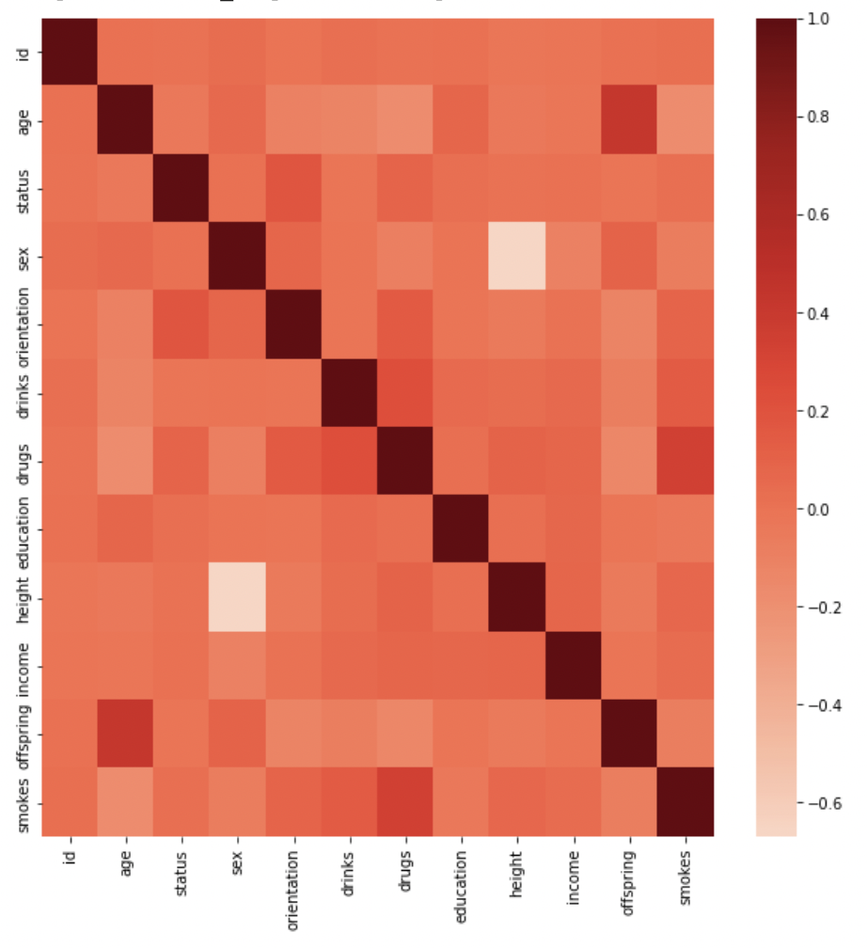
Principal Component Analysis
We do PCA for the numerical variables.
Variable has low correlation with each other.

Slide 6
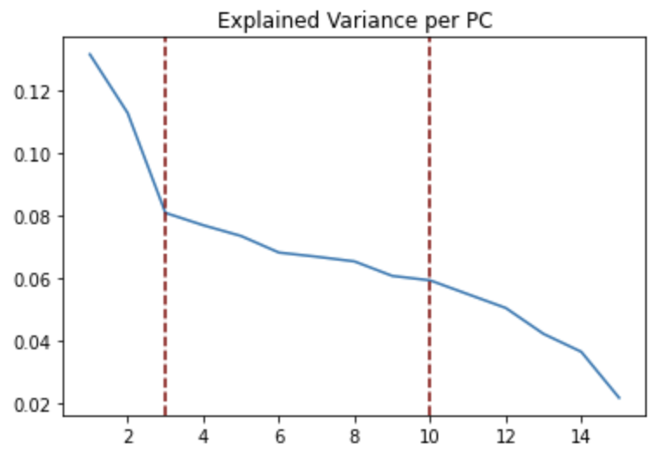
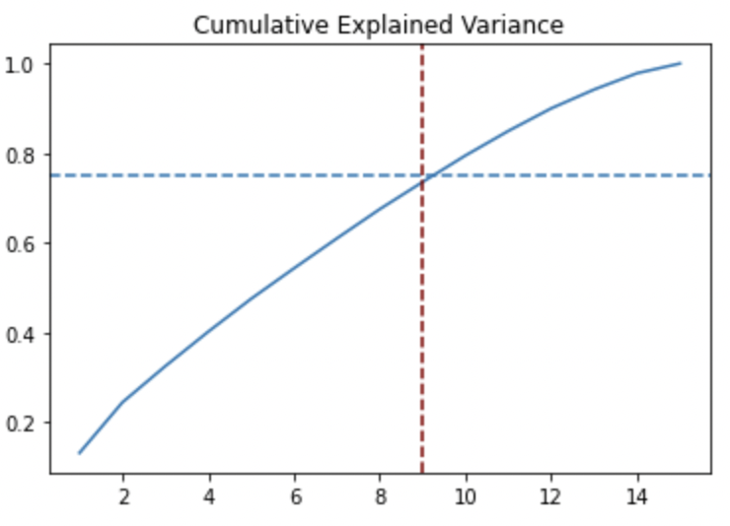
Principal Components Analysis
We decided to retain 9 components from the explained variance plots.

Slide 7
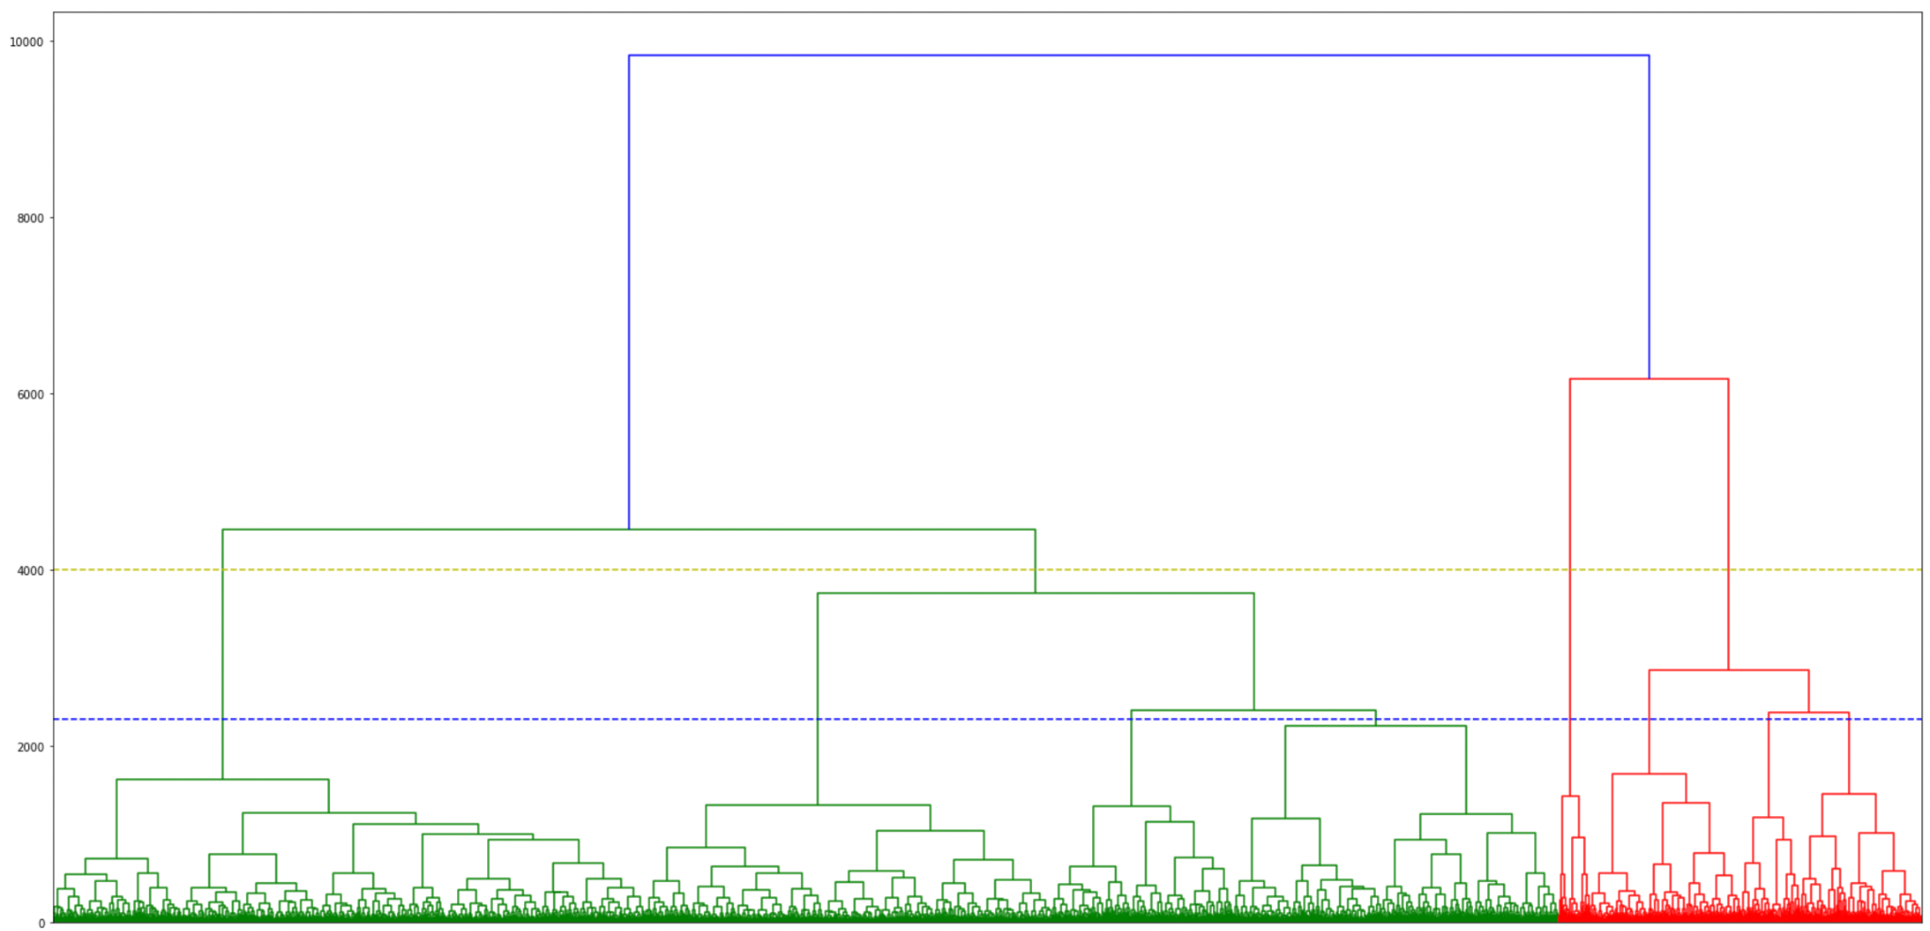
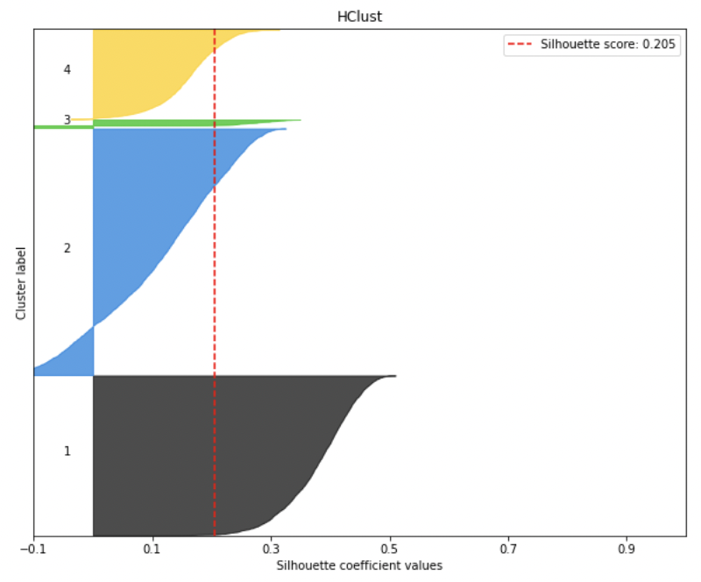
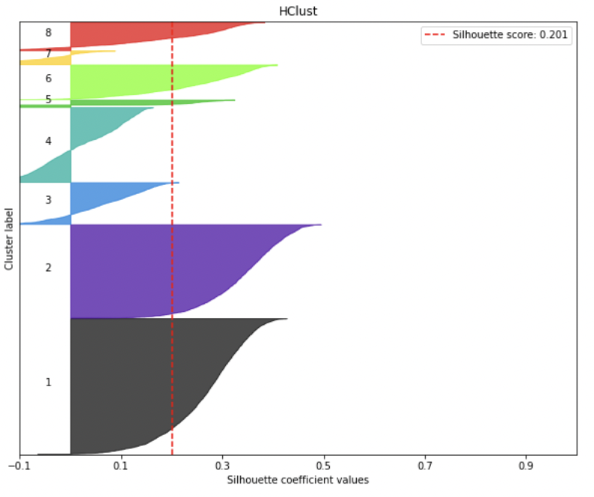
H-Clustering
Linkage method: single,complete, average, ward
4 clusters
Silhouette score: 0.205
8 clusters
Silhouette score: 0.201

Slide 8
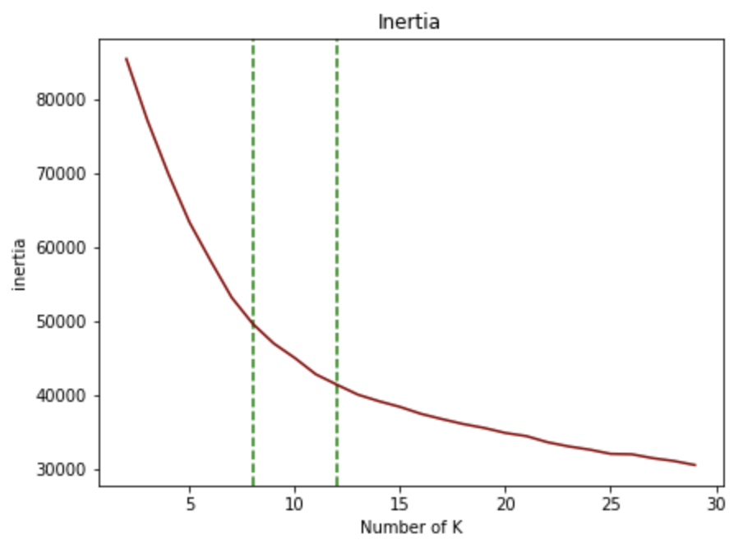
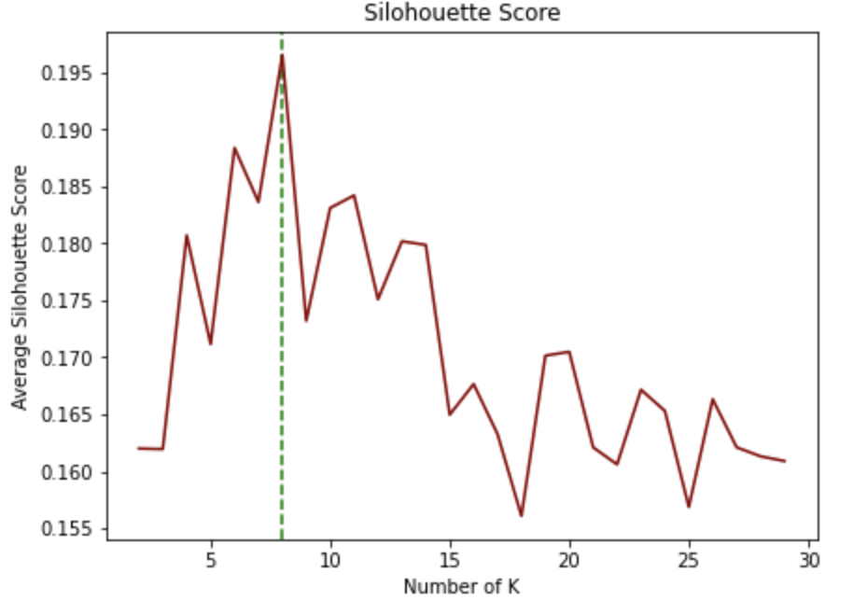
K-Means
PCS: retain 9 pcs after looking at the average silhouette score
K: Based on Inertia plot and Silhouette Score Plot
PC | K | Avg.silhouette score
14 | 9 | 0.160
9 | 8 | 0.196
8

Slide 9
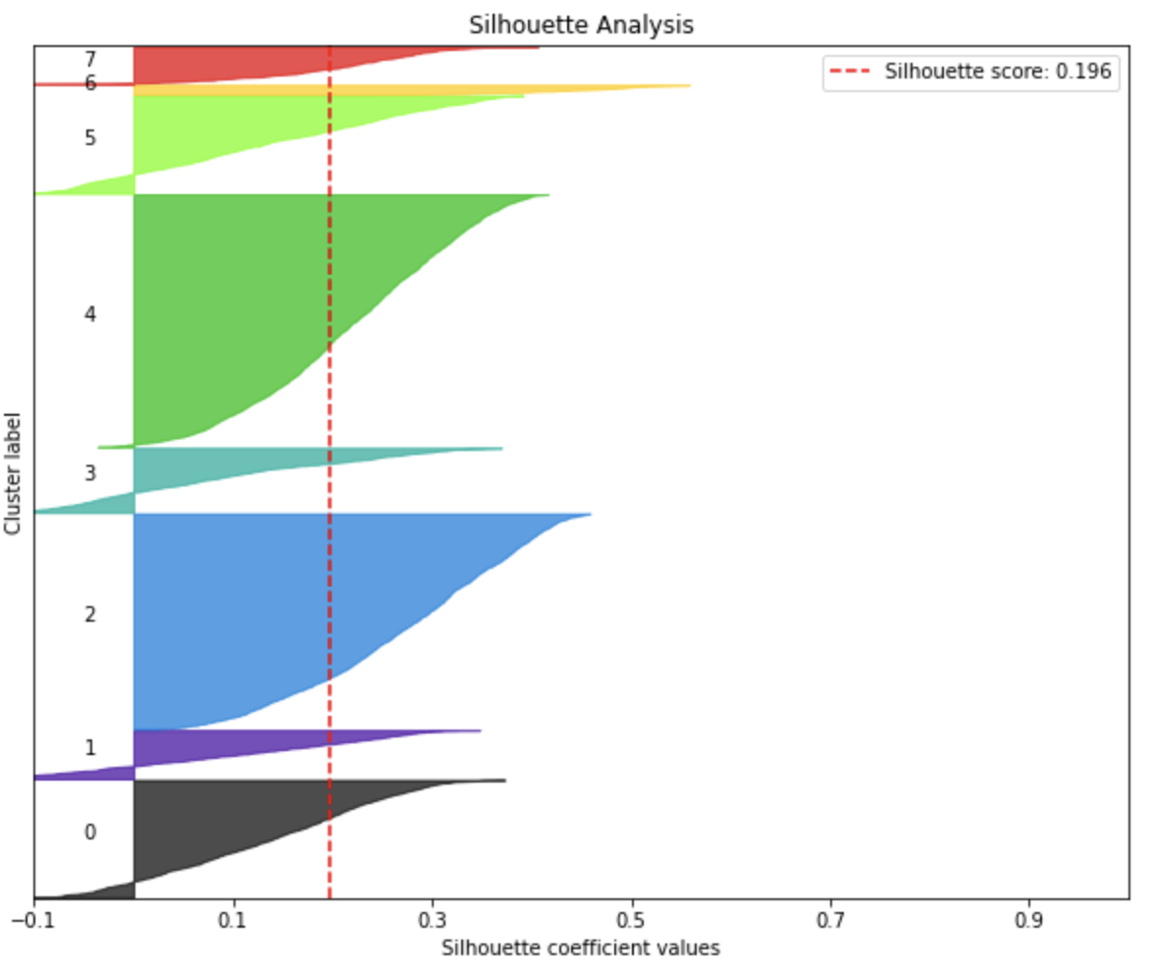
K-Means
Silhouette Analysis
Silhouette Score: 0.196
Some negative values
Size of the cluster is uneven

Slide 10
H-clusters and K-Means Clusters
Trade-off

Slide 11

H-Clustering or K-means
Compare the Silhouette average Score
Best H-clustering:
0.205 for 4 clusters
0.201 for 8 clusters
Best K-means:
0.172 for 4 clusters
0.196 for 8 clusters
Make a decision with our business problem

Slide 12
Text Analysis
Step 1: Tokenizer - Spacy
Model used “ en_core_web_md”
Only include ‘tok2vec’
Step 2 : Reducer - PCA; UMAP
Step 3: Using K-Means to do classification
Classification

Slide 13
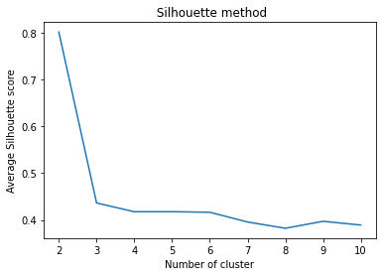
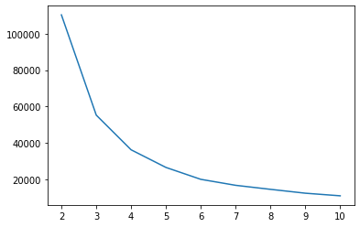
K-means clustering for unsupervised learning
Elbow method
Silhouette score

Slide 14
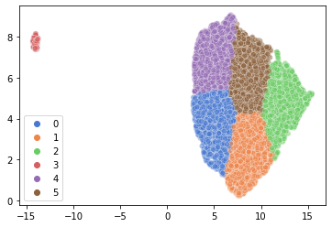
6 Clusters (Silhouette score = 0.42 )
It might be some outlinear data
Clusters are evenly distributed
Having 6 clusters fits our business better

Slide 15
Findings &
Recommendations
Conclusions
Limitations
Looking Forward...

Slide 16
Findings and Recommendations
Based on our earlier findings, we are good to see that we have
8 clusters for our numerical part (basic information of users)
6 clusters for our text part (text description about their preference)

Slide 17
Findings and Recommendations
This is how things works:
Input newbie users’ required information, the system will automatically assign him/her into the basic user pool according to our first clustering algorithm.
What do we know about Caroline?
age - 22 | status - seeing someone | sex - female | Orientation - straight | Body_type - average
Diet - anything | Drinks - rarely | Drugs - never | Smokes - no | Education - masters
Height - 174cm | Income - 0 (as student) | Offspring - no or dont want | Pets - has dog and has cat | About yourself? (text..)

Slide 18
Findings and Recommendations
The system will automatically assign him/her into the basic user pool according to our first clustering algorithm.
Cluster 2! Good to know!
What do we know about Caroline?
age - 22 | status - seeing someone | sex - female | Orientation - straight | Body_type - average
Diet - anything | Drinks - rarely | Drugs - never | Smokes - no | Education - masters
Height - 174cm | Income - 0 (as student) | Offspring - no or dont want | Pets - has dog and has cat | About yourself? (text..)

Slide 19
Findings and Recommendations
Once the user has been placed on their ‘planet’, fill in other selective verbal descriptions at least one. That way our second sorting algorithm will be working on it and sort the user into the second pool as well.
One sentence about yourself?
What are things that can make you happy?
Description about your ideal future.
......
Cluster D! (D2)

Slide 20
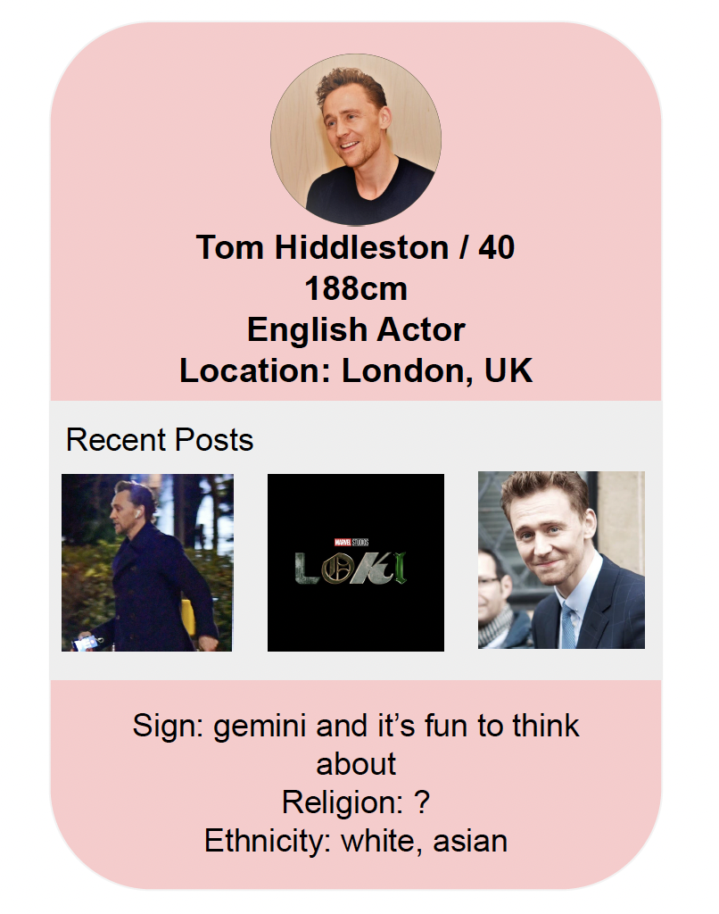
Findings and Recommendations
Once the user has been placed on their ‘planet’, fill in other selective verbal descriptions at least one. That way our second sorting algorithm will be working on it and sort the user into the second pool as well.
One sentence about yourself?
What are things that can make you happy?
Description about your ideal future.
......
Cluster D! (D2)

Slide 21
Limitations
Moreover, we still have some limitations.
We currently have no means to deal with the users’ location. But due to our raw material, the main resource of our user is southern California, so we would like to put the precise location into users’ profile after being sorted into two precise pools. That way, people can think for themselves whether they care about it or not. (Like we did with Hiddleston :)
Applying cdist to determine the distance between two datasets for next step

Slide 22
Questions?

